Slide 1

Theory of Mind and Intent in Procedural Agents: Learning Lessons from Improvisational Theater and Text-based Adventure Games
Jonathan May
University of Southern California Information Sciences Institute
Penn CIS 700 – Interactive Fiction and Text Generation
April 12, 2022

Slide 2
Motivation For This Talk
This class is ultimately about improving storytelling technology
Storytelling is fundamentally dialogue – whether teller and recipient are separated or integrated roles
Dialogue is fundamentally about the merging of minds to share a constructed reality
Of course we’re all about dialogue technology
So let’s talk about bots

Slide 3
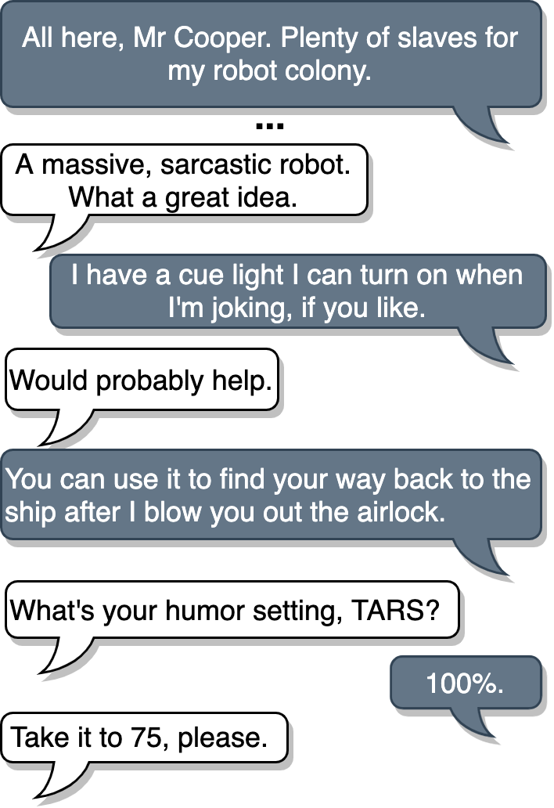
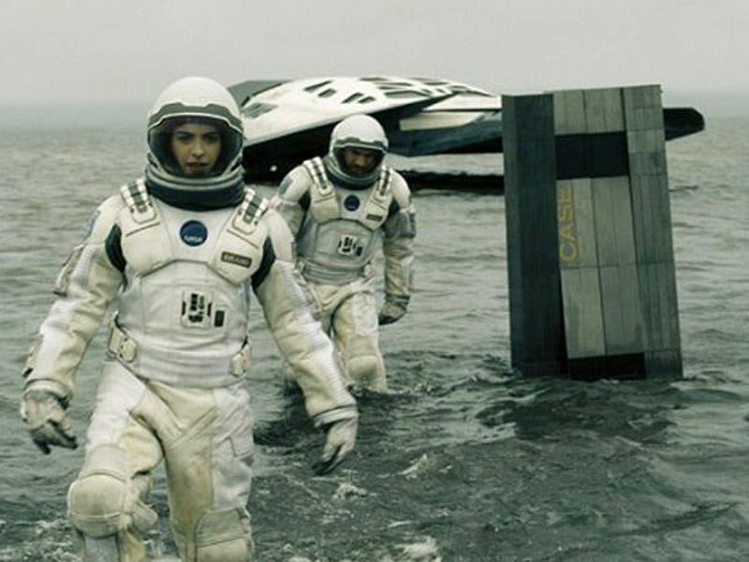
Ideal Bots…
are fun dialogue partners!
TARS
Cooper
TARS
Cooper
TARS
Cooper
TARS
Cooper
Interstellar (2014)
Notes:
I realize that not everybody is in the NLP space, so I’ll take some time to explain dialogue systems. There’s mianly two kinds, task-oriented and open-domain or conversational dialogue systems. The latter is what our work is focusing on improving, and here are some fictional examples that are greate examples.

Slide 4
Ideal Bots…
understand your needs and act on them!
Tony Stark
J.A.R.V.I.S.
Iron Man, et al. (2008-2015)
Notes:
Conversational dialogue systems have come a long way, starting from Eliza that uses rule-based heuristics to mimic a psychotherapist to completely end to end models based off of GPT-2 with billlions of parameters trained with billions of sentences. However, modern neural conversational dialogue systems still exhibit a number of common issues that show that there is still a long way to go before we can be talking to TARS or Samantha.

Slide 5
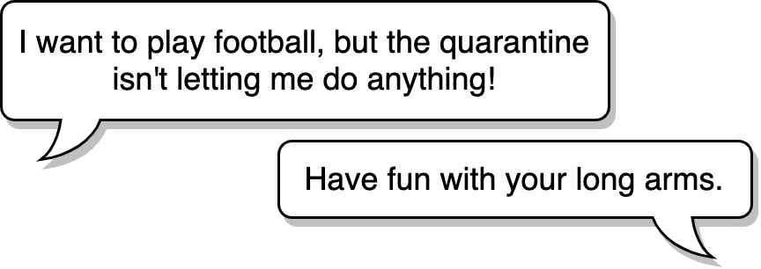


Real Bots…
give irrelevant, non-sensical responses
DialoGPT (Zhang et al. 2019)
Notes:
As part of the trade-off to become general enough to answer anything, the models sometimes respond with something that is completely irreleveant and non-sensical. Look at this response from a DialoGPT model released late last year by Microsoft.
THe rep
Should I / Do I have time to list related work that have previously tried to address these issues and how they overlooked this aspect of communication.
First example from mitsuku: winner of the Loebner Prize a record 5 times.
https://www.pandorabots.com/mitsuku/
Second example from DialoGPT implementation on colab, link from official DialoGPT repo: https://colab.research.google.com/drive/1PslHE4Rl4RqSa20s7HEp0ZKITBir6ezE
Cleverbot example from cleverbot

Slide 6
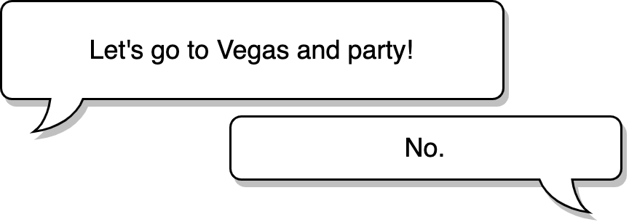

Real Bots…
give relevant but non-specific responses
Cleverbot (https://www.cleverbot.com/)
Notes:
Another commonly known problem is responding with a relevant but generic response that could work for many cases, such as I don’t know or simply No or Yes in this example. This preempts further conversation or forces the user to be creative in order to continue a conversation.
We believe that these responses we’ve shown you are undesirable because of a lack of grounding.

Slide 7
Real Bots…
don’t make good decisions about what to say next
Alexa Prize 2017 winner (sounding-board.github.io)
Notes:
Another commonly known problem is responding with a relevant but generic response that could work for many cases, such as I don’t know or simply No or Yes in this example. This preempts further conversation or forces the user to be creative in order to continue a conversation.
We believe that these responses we’ve shown you are undesirable because of a lack of grounding.

Slide 8
Real Bots…
don’t have common sense
Alexa
Notes:
Another commonly known problem is responding with a relevant but generic response that could work for many cases, such as I don’t know or simply No or Yes in this example. This preempts further conversation or forces the user to be creative in order to continue a conversation.
We believe that these responses we’ve shown you are undesirable because of a lack of grounding.

Slide 9
Necessary Conditions
(not covered today)
(Samantha from Her)
Engaged Understanding
Decision-Making

Slide 10
Today’s Talk
Introduction (nearly done!)
Improving grounding in dialogue via improvisational theater
Learning to make decisions by playing text adventure games
Hyundong (Justin) Cho
Xusen Yin

Slide 11
Hyundong (Justin) Cho
(Cho and May, ACL 2020)
Engaged Understanding
Decision-Making

Slide 12
Grounding in Dialogue
I love Star Wars
Types of evidence of understanding (Clark and Shaefer, 1989)
Display → verbatim repetition
Demonstrate → articulate part of input
Acknowledgement → Nodding or expressing agreement
Initiation of relevant new contribution→ Start in on the next contribution that would be relevant at a level as high as the current one
Relevant new contributions move the discussion along
I think you said “I love Star Wars.” Is that right?
The droids are so cute
Yep, the droids
My kids have all the toys
Uh huh
I dressed up as a Wookie for Halloween
You must have been hot in all that fur

Slide 13
Improvisational Theater (Improv)
Note: not “improv comedy” (though in practice we will be using comedic texts)
Grounding very important due to lack of objective reality
Next relevant contribution in improv-space = “Yes, and”
I feel so miserable in this rain
You must be drenched without an umbrella

Slide 14
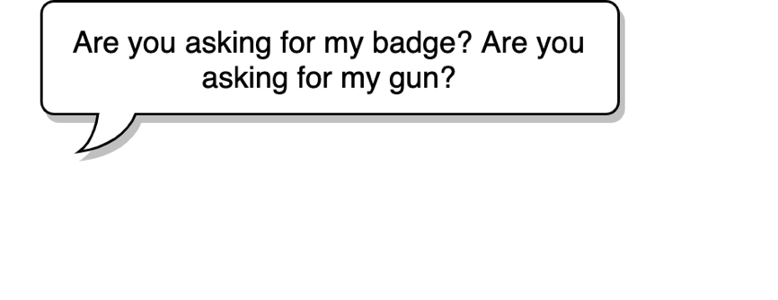
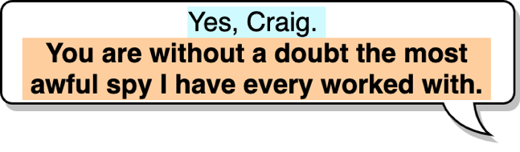
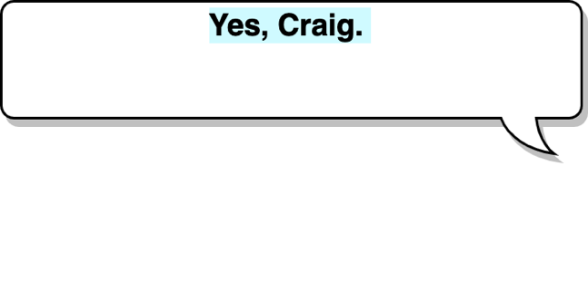
Yes-And
Key grounding technique used in improv
A prompt (turn) establishes some information about the current scene that the actors are a part of
The responding turn should
accept the given reality from previous dialog turns (“Yes”)
and add new information to refine the given reality (“and”)
We call these turn pairs yes-ands
How can we use improv to build dialogue systems better at grounding?
Notes:
For our work we're drawing inspriation from improvisational theatre, improv because improvisers rely on various grounding techniques to act out a scene. One o the most important principles in imprvo is yes-and principle. It states that ...

Slide 15



A Basic Strategy
Collect yes-and corpus
Fine-tune dialogue model
Evaluate: is the model better?
A
Yes-Ands!
++
I prefer bot B
B

Slide 16

Limitations of Existing Dialogue Datasets
Most text-based dialogue corpora are scripted and have small proportions of yes-ands (Only 11.1% for Cornell)
DailyDialog
(Li et al. 2017)
104K utterances
Persona-chat
(Zhang et al. 2018)
162K utterances
Cornell Movie-Dialogs Corpus
(Danescu-Niculescu-Mizil and Lee, 2011)
304K utterances
OpenSubtitles
(Lison and Tiedemann, 2016)
441M sentences
Notes:
So what do we have at hand to take advantage of?
Well there are existing text-based dialogue datasets.

Slide 17
What about existing improv corpora?
None!
Most spontaneous dialog data are audio recordings
What about making a corpus?

Slide 18
Problems
Improv speech corpus pretty hard to find too!
Whose Line Is It Anyway? (maybe 4-5 lines per sketch)
Improv venues don’t record (or don’t share)
YouTube videos (noisy, bad quality)
Sketch comedy (pretty small, not a lot of yes-ands)
Podcasts!
Spontaneanation, with Paul F. Tompkins
200 episodes, 30 minutes of improv in each one
No transcripts, but decently clean audio

Slide 19
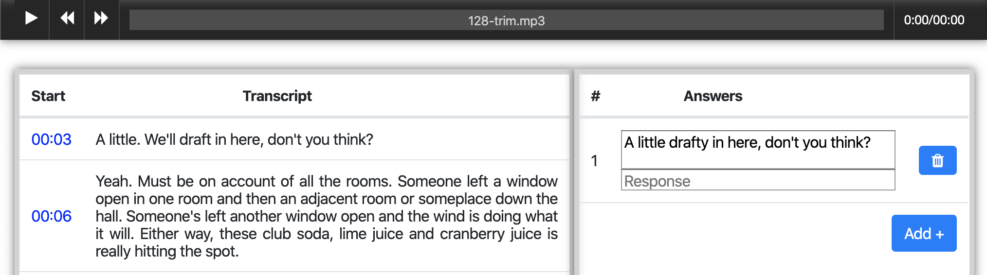
Mechanical Turk Interface
→ 10,459 yes-ands from Spontaneanation. Not enough!
Notes:
On the same slide say how mnay have been collected, emphasize it’s not huge compared to other corpora

Slide 20

Cornell Movie-Dialogs Corpus
Most similar in domain to Spontaneantion among existing text-based dialog corpora
Larger than Spontaneanation but lower concentration of yes-ands
DailyDialog
(Li et al. 2017)
104K utterances
Persona-chat
(Zhang et al. 2018)
162K utterances
Cornell Movie-Dialogs Corpus
(Danescu-Niculescu-Mizil and Lee, 2011)
304K utterances
OpenSubtitles
(Lison and Tiedemann, 2016)
441M sentences
Notes:
This is not enough.

Slide 21
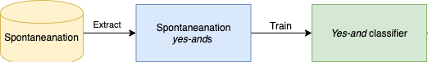
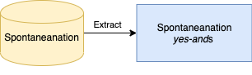
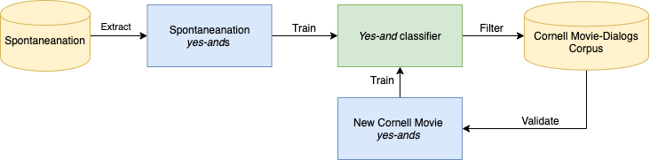
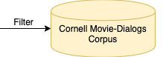
Data Augmentation
Notes:
Let’s try this idea of bootstrapping

Slide 22
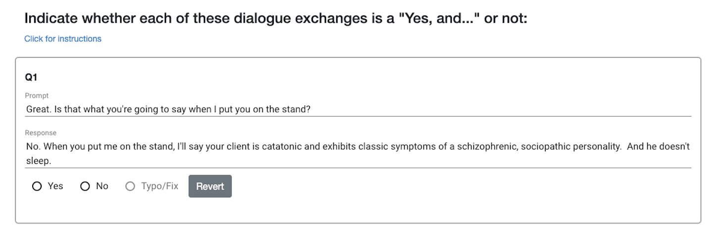
Validation Interface

Slide 23
Retrieval Results
Precision
26.9%
44.0%
72.9%
78.4%
Equal number of Non-Yes-Ands also sampled

Slide 24
Selected Pairs Of Learnable ImprovisatioN (SPOLIN)
Contradiction (5%)
P: Hey, hey, aren’t you afraid you’ll burn out a tonsil?
R: Tonsil? Me? No! Me burn a tonsil?
Explicit (15%)
P: Does this map look homemade to you?
R: Yeah, it looks like someone without a grasp of English drew it.
Implicit (78%)
P: Alright, pull up that plate so I can take a picture.
R: Sorry, the coleslaw is definitely giving off a lot of glare.
Other (95%)
P: I feel different right now.
R: You wait and see. You’re going to marry a big hero!
Yes-but (7%)
P: We all must say the chant that we say to the king.
R: No, it’s too erotic, please don’t.
Notes:
We call our corpus the Selected Pairs of ImprovisatioN corpus, after Viola Spolin.
(Not sure if showing specific types is very useful)
Labelling a subset of the development set shows that most yes-ands are implicit and that only a few non-yesands are contradictions. It shows that in most cases, at least in movies and improv, the reality projected by a previous dialogue turn is rarely outrightly rejected. Usually, it is more irrelevant.
Just a piechart – and just call out the types
Make some examples shorter to make it cleaer

Slide 25
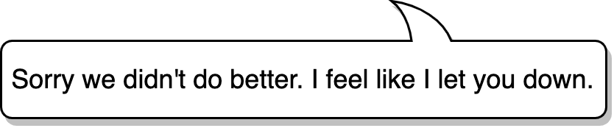



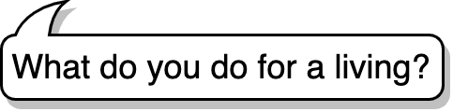
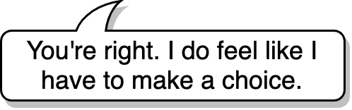
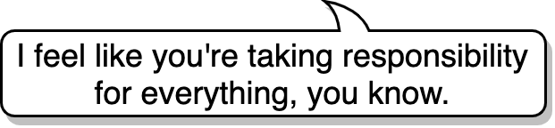
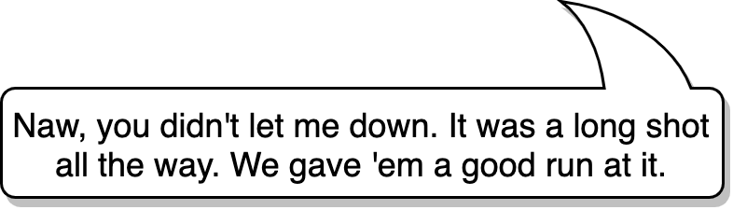
Evaluation
Prompt
Rank responses from GPT-2 models and SPOLIN
Other
SPOLIN
Other → SPOLIN
Gold
SPOLIN
Other = Persona-chat, DailyDialog, Cornell Movie-Dialogs Corpus
(Zhang et al. ‘18)
(Li et al. ‘17)
(Danescu-Niculescu-Mizil and Lee ’11)
Notes:
Explain what others are:

Slide 26
Evalution Results
Average Rank
Other
SPOLIN
Other → SPOLIN
Gold
Notes:
Evaluation results show improvements compared to existing datasets, although fine-tuning models with both existing dataset and SPOLIN does not lead to significant improvement except for Persona-chat.
Keep the average of all the models since the pattern is consistent and show fewere examples

Slide 27
SPOLIN-extended
Extract more yes-ands from SubTle (Eng) (Ameixa et al., 2013), a preprocessed subset of OpenSubtitles
Collect an additional 40,000 yes-ands
DailyDialog
(Li et al. 2017)
104K utterances
Persona-chat
(Zhang et al. 2018)
162K utterances
Cornell Movie-Dialogs Corpus
(Danescu-Niculescu-Mizil and Lee, 2011)
304K utterances
OpenSubtitles
(Lison and Tiedemann, 2016)
441M sentences
Notes:
68K yes-ands & 44K non-yes-ands
Reason for only going through a subset of SubTle:
Heuristics for finding alternations mean that SubTle's utterances are shorter than those in Spontaneantion and Cornell, so once the proportion of utterances longer than the average length of in Spontaneanation and Cornell (18.5 words) is less than 40%, we stop further collection in the remainder of the dataset.
This was collected after the paper submission and with the evaluation results, so the extended version of the dataset has not been systematically evaluated.
Get back to the cylinder diagram and circle subtle and explain it

Slide 28
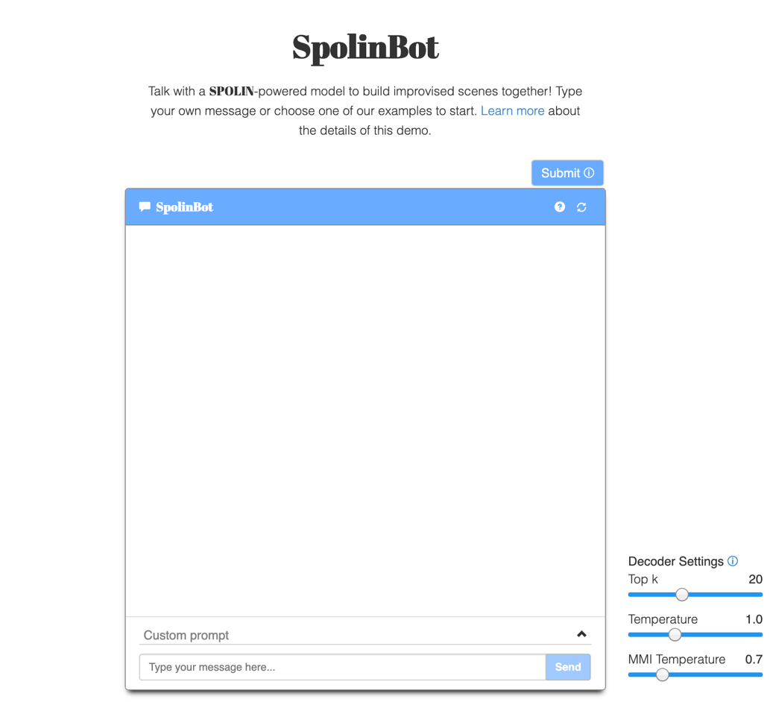
Demo
Built interactive demo with a DialoGPT model fine-tuned with SPOLIN-extended
Uses a reverse model for maximum mutual information (MMI) (Li et al. 2015)
The more creative you are, the more creative it will be
spolin.isi.edu
Notes:
Show demo if there is time for it. (Or show examples on project page: https://spolin.isi.edu)
Cherrypick some prompts that have shown promise to be relatively consistent. Refer to examples on project page.
Give a lot of caveats before doing the live demo (warnings and apologies)
Turning up temperature a bit and MMI temp considerably was quite useful

Slide 29
Demo!
spolin.isi.edu

Slide 30
Contribution Summary
SPOLIN corpus
Publicly available at https://github.com/wise-east/spolin
Useful for fine-tuning existing dialogue systems to elicit creative grounding capabilities
Beyond computer science, the corpus can be useful for empirical sociolinguistic studies on the yes-and dialogue act
Train a high-precision yes-and classifier to mine yes-ands from dialogue corpora with high volume but low yes-and density
Fine-tune existing conversational models with our corpus and show via human evaluations that this approach improves creative grounding
Notes:
(Contributions paraphrased or copied from paper)

Slide 31


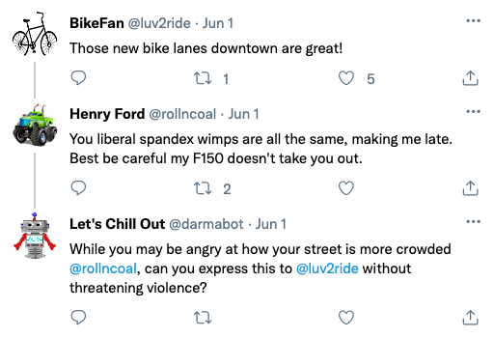
What’s Next?
Welcome to McDonalds, can I take your order?
Mah hoss and I are mighty dusty, he’ll have a trough of water and I could use some sasparilla, thank ya kindly.
We require sustenance to prevent our cells from deteriorating in your world’s harsh oxygen-rich environment. Please prepare strands of complex protein.
We’ve shown we can encourage models to Yes-And, i.e. to engage in a general offer technique
Acting involves character; can we encourage models to generate with this in mind?
More interested in stylistic expression rather than token choice
Use case: DARPA Civil Sanctuary
Can we create conflict negotiation models?

Slide 32
Xusen Yin
(Yin and May, 2019 CoG)
(Yin et al., 2020 EMNLP Findings)
Engaged Understanding
Decision-Making
Via Text Games

Slide 33
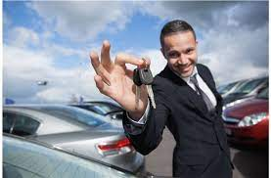
Real-World Decision-Making (diplomacy)
(Illustrated for slide enjoyment purposes only.)
You want a car. The price is $10,000 but you only have $7,000. The dealer looks at you distrustfully. What do you do?
Buy a cheaper car
Steal the car
Ask for a discount
Ask about the dealer’s family
Ask about the dealer’s sports interests
Flirt with the dealer
...

Slide 34
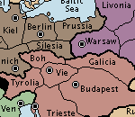
Tough Proxy Decision-Making (Diplomacy)
Your army is in Warsaw. You want to take Galicia but need support. What do you do?
Take Prussia instead
Ask the army in Silesia to help you
Ask for help but promise to help the Silesia army take Bohemia next turn
Ask for help from Silesia to attack Galicia and ask Galicia to attack Silesia and double cross Silesia
...

Slide 35
Reasonable Proxy Decision-Making (Text Games)
(Illustrated for slide enjoyment purposes only.)
North
West
South
You are in a dark forest at a crossroads. A large friendly tree is nearby. Paths run to the North, East, West, and South. A loud commotion is coming from the South. A glowing light appears in the West in the distance. You are famished.
What do you do next?

Slide 36
Is Playing Games Easier than Dialogue or Making Decisions in the Real World?
The game is a finite-state machine
Concrete scoring system – amenable to reinforcement learning
Simple command parser – usually no more than four words per player utterance
Still very challenging!
Unbounded potential action space
Even with known action space you still have hundreds of necessary actions
Sparse scoring
Humans still far superior

Slide 37
Learning To Play (Video) Games – Mnih et al. 2013
Choose the best action
and take it!
Deep Q-Learning with experience replay
Q(s, a) : estimated total reward if you take action a at state s
Deep: state formed by some DNN representation of input
Collect partial game play and learn from it
↑ | ↗︎ | → | ↘︎ | ↓ | ↙︎ | ↖︎ | O
6000 | 1000 | 500 | 500 | 1000 | 250 | 750 | 14000
Predict Q for all actions a
Representation (e.g. CNN)
Encode into state s
Input

Slide 38
Collect Experience Pool
r: +10
Pool
s a r s’
400
s’
(
, O, +10,
)
Q:
↑ | ↗︎ | → | ↘︎ | ↓ | ↙︎ | ↖︎ | O
6000 | 1000 | 500 | 500 | 1000 | 250 | 750 | 14000
a: O
400
DQN
(
, ↙︎, -5,
)
… x 500,000
s

Slide 39
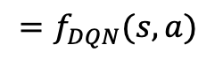
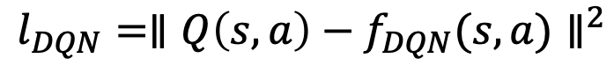
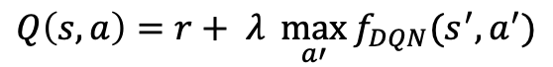
Optimize Q-function
Try every action!
DQN
(Bellman equation)
$$Q\left(s, a\right)=r+ λ \max_{a′}{f_{DQN}(s^{′}, a^{′})}$$
sample
s
a
r
s’
13700
(
, O, +10,
)
14000
$$=f_{DQN}(s, a)$$
400
s
a
r
s’
)
(
, O, +10,
)
DQN
(
, ↙︎, -5,
… x 500,000
(
, O )
$$l_{DQN}=∥Q\left(s,a\right)−f_{DQN}(s,a)∥^{2}$$
need to estimate

Slide 40
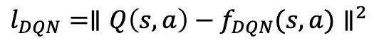
Deep Q-Learning With Experience Replay
collect
play
DQN
optimize
$$l_{DQN}=∥Q\left(s,a\right)−f_{DQN}(s,a)∥^{2}$$

Slide 41
From Video Games to Text Games
State Signal
“You find yourself in a kitchen. You see a counter. On the counter you can make out a knife.”
trajectory of prior text (sequences of descriptions and responses)
frames from game
Action Space
pick up knife
slice potato with knife
climb on counter
↑ | ↗︎ | → | ↘︎ | ↓ | ↙︎ | ↖︎ | O
Joystick, button press
action space: possible next commands
O(100)…theoretically unbounded
DQN
(Q estimator)
CNN
Also CNN!*
workhorse of
image recognition
LSTM too slow, not worth it!
(Yin and May 2019)

Slide 42
*
We actually use a Deep Reinforcement Relevance Network (DRRN)
Unlike in video games, actions have some semantic content
Action and trajectory encoded separately (speeds things up a bit) then combine to get Q
(He et al, 2016)

Slide 43
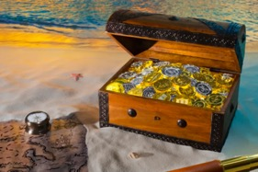
Evaluation Scenarios
Train
Test
Test-on-Train (e.g. Mnih et. al.)
Not interesting to us!
In-Domain
444 held-out cooking games
3,956 Cooking Games
Out-Of-Domain
Only data seen by models during learning
208 treasure-hunting games
All games from TextWorld (Côté et al 2018)

Slide 44
Typical Cooking Game (edited heavily to fit on one slide)
Let's cook a delicious meal. Ingredients: block of cheese, water, yellow bell pepper. Directions: grill the block of cheese, dice the yellow bell pepper, roast the yellow bell pepper. You are in a pantry. There is an open frosted-glass door leading north.
go north
You're now in the kitchen. The fridge contains some water, a block of cheese, a diced yellow bell pepper, a raw yellow potato, and a cilantro.
take block of cheese from fridge
You take the block of cheese from the fridge. Your score has just gone up by one point.

Slide 45
Baseline and Evaluation Procedure
Train DRRN on 3,956 cooking games for 10m steps
Curriculum learning approach: train on the easy games first
At each step in training and evaluation, admissible actions (steps you can take next) are available
Evaluate on in-domain (cooking) and out-of-domain (treasure) games
Metric = total % of available score
Not good generalization!
Test-on-Train
75%

Slide 46
What happens on out-of-domain test?
Your first objective is to pick up the keycard in the cubicle. Then, insert the keycard into the box within the cubicle's lock to unlock it…. You are in a cubicle. You make out a locked chest. You see a locked type A locker here. You can see a box. There is a closed passageway leading west. There is a keycard and a worm on the floor.
inventory
You are carrying:
a gummy bear
a latchkey
drop latchkey
You drop the latchkey on the ground.
examine gummy bear
that's a normal gummy bear!
???
eat gummy bear
You eat the gummy bear. Not bad.
You had one job!

Slide 47
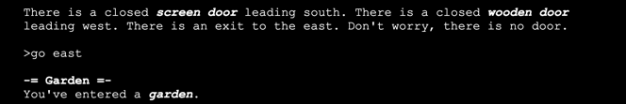
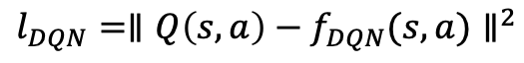
What’s Wrong?
No Common Sense
No Background Knowledge (never saw locks, keys, etc.)
Where can we find a general source of knowledge?
collect
??
+
DRRN
$$l_{DQN}=∥Q\left(s,a\right)−f_{DQN}(s,a)∥^{2}$$
optimize

Slide 48

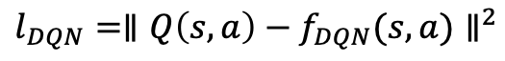
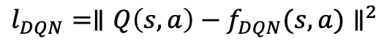
BERT* Slows Everything Down!
collect
collect
DRRN (CNN)
DRRN (BERT)
$$l_{DQN}=∥Q\left(s,a\right)−f_{DQN}(s,a)∥^{2}$$
$$l_{DQN}=∥Q\left(s,a\right)−f_{DQN}(s,a)∥^{2}$$
optimize
optimize
3 weeks to train
2 years to train!
64-dim representations
32 x (3, 4, 5) filters max pooling
91,000 parameters
bert-base uncased
12 layers, 12 heads, 768-dim FF
110m parameters
(P100 GPU)
* A Transformer of BERT’s size

Slide 49
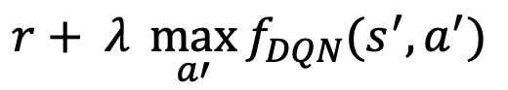
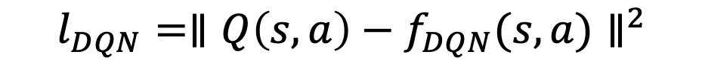
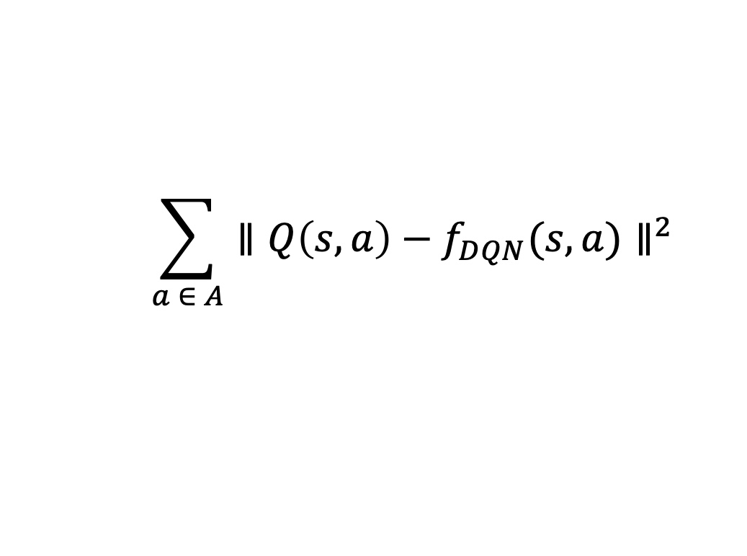
Why So Slow?
$$l_{DQN}=∥Q\left(s,a\right)−f_{DQN}(s,a)∥^{2}$$
estimated as
$$r+ λ \max_{a′}{f_{DQN}(s^{′}, a^{′})}$$
1) Q(s, a) is slow to compute! The max requires a lot of extra computation
2) The loss is inefficient! We’re only considering one action per state. We’d like a loss like this:
$$\sum_{a ∈ A}{∥Q\left(s,a\right)−f_{DQN}(s,a)∥^{2}}$$

Slide 50

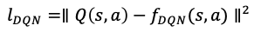
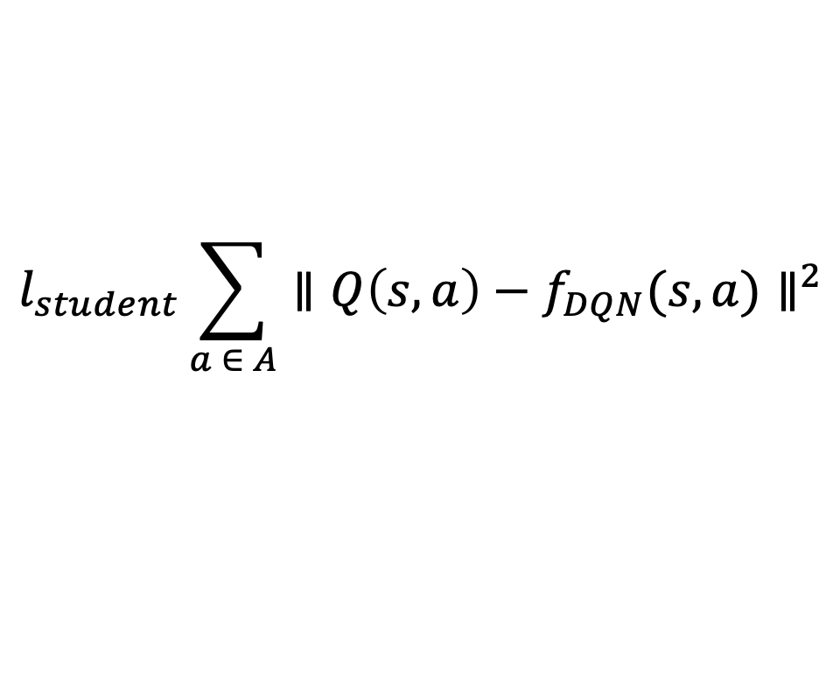
Speed Things Up with Imitation Learning
sample
Trajectory Pool
collect
trajectory1
DRRN
trajectory2
+
DRRN
$$l_{DQN}=∥Q\left(s,a\right)−f_{DQN}(s,a)∥^{2}$$
optimize
trajectory3
Teacher DQN: a proxy for Q(s, a)
Trained Teacher Model
…
easy to calculate!
no Bellman needed!
Student
New DQN
$$l_{student}\sum_{a ∈ A}{∥Q\left(s,a\right)−f_{DQN}(s,a)∥^{2}}$$
lots of learning in every step!

Slide 51
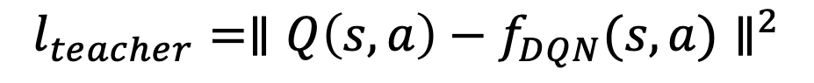

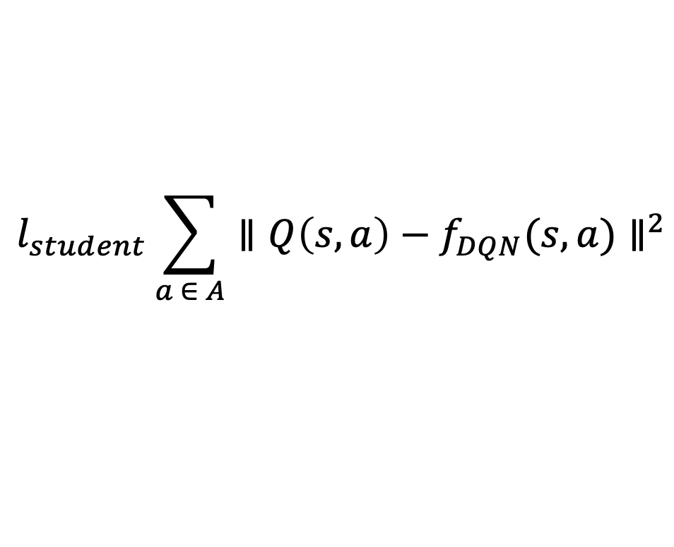
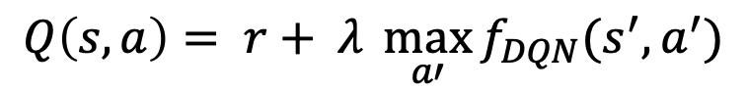
Speed Things Up With Imitation Learning!
Teacher model:
+ exploration of entire space
- cheap model, no external knowledge or generalizability
Student model
+ very fast
+ has external knowledge to learn from
- can’t explore the game space
$$l_{student}\sum_{a ∈ A}{∥Q\left(s,a\right)−f_{DQN}(s,a)∥^{2}}$$
$$l_{teacher}=∥Q\left(s,a\right)−f_{DQN}(s,a)∥^{2}$$
$$Q\left(s, a\right)= r+ λ \max_{a′}{f_{DQN}(s^{′}, a^{′})}$$
$$Q\left(s, a\right)= f_{teacher}(s, a)$$

Slide 52
Consequences: More Complex State Encoders
DQN/Teacher Model
CNN (91,000 parameters)
Student Model
CNN (91,000 parameters)
BERT (110M parameters)
CNN+GloVe (CNN with background knowledge)
Transformer (BERT without background knowledge)
No New Training Data
DRRN
BERT

Slide 53
In-Domain DRRN Students
No student model has information beyond the teacher models
BERT as a DRRN student model is able to exceed teacher performance
cf. parent trained
for 10m steps

Slide 54
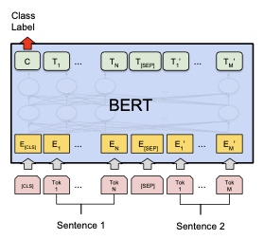
Inspiration from NLU
=BERT-NLU-SE
Q(s,a)
action = argmax Q(s, a)?
= BERT-NLU-CE
BERT (Devlin et al. 2019) popularized the use of large contextualized language models as classifiers
What if we encode the action along with the trajectory and choose the argmax class from Q?
Wait, why not just directly predict Q(s, a)?
trajectory
action

Slide 55
In-Domain BERT Students
BERT-NLU-SE is much better than parent!
Reaches its convergence point in only 100k steps (2 orders of magnitude faster than parent)
Why?
If you prepare an ingredient wrong, you lose (e.g. if you use the oven when instructions say to fry); BERT has background info
BERT-DRRN doesn’t pay enough attention to actions
BERT-NLU-CE is lossy; doesn’t reflect bad action vs. unhelpful

Slide 56
Out-of-Domain BERT Students
None of these models have seen treasure hunting games prior to evaluation
BERT-NLU-CE inclined to strong opinions even when wrong

Slide 57
Summary
Efficient integration of large contextualized language model in deep Q-learning framework via
Imitation learning
recharacterization of DQN as NLU
Dramatic gains in domain-transferred decision-making learning capabilty

Slide 58
What’s Next?
Domain transfer to Diplomacy! (DARPA SHADE)
World space is fairly constrained: one map, finite actions
Extra difficulty: playing against humans and/or other agents!

Slide 59
Connecting The Pieces
Unbounded Expression
Planning Toward Goal
Coherence
Long-Term Strategy
Natural Experience
Get To The Right Place
Theory of Mind
Is the response what I would expect a rational mind on the other end of the
line to provide?
Open Challenge:
The right evaluation framework for both
of these at the same time.
Engaged Understanding
Decision-Making

Slide 60
Thank You!
jonmay.net jonmay@isi.edu
justin-cho.com jcho@isi.edu xusenyin@isi.edu
Sponsored in part by DARPA and IARPA.
The views and conclusions contained herein are solely those of the authors.

